Slide 1
Keeping Moms and Infants Healthy Team Member(s): Noe Velasquez, Gabriel Alfonso, Michael Llanes, Amin Sheikhnia Product Owner(s): Jean Hannan Professor: Masoud Sadjadi School of Computing and Information Sciences Florida International University
VIP/Senior Project Final Presentation Summer 2020
07/31/2020
Notes:
Greet your audience, thank them for attending your presentation, introduce yourself, introduce your project, introduce your team members, and quickly indicate what each of you did in a high-level manner, and put more emphasis on your part/contribution.

Slide 2
Problem definition
Whole Project:
There is currently little to no resources for low income mothers on how to manage their pregnancy. There is no organized access to clinics that offer a lot of free resources that could help a mother and her baby get a better life.
My Part:
Noe: I focused on working on the setting, appointment, and reference features. I've implemented a setting where users are allowed to change/update their personal information. As well, implemented references where the user can reference any medical specialties and have access to call or email them. In addition, the user can schedule appointments for any medical purpose.
Amin: I focused on working on STDs, female condoms, and a little bit of appointments. I’ve implemented several features where STDs and the female condom are depicted and described to the user. I’ve also implemented a part of appointments allowing for the appointment to be added to the database.
Gabriel: I focused on working on the Map, Clinics, Shelters, Weekly SMS, Appointment Reminder, LowerPanel. I’ve implemented many of the cloud functions in the app. Also redesigned the Map, the clinics and introduced shelters to the app. I also made several changes to the sign up process.
Michael: I focused on constructing the Resources Page which includes Document uploading, Appointments & References noting, and links to government resource applications. I implemented the full document uploading feature that allows the user to upload images and name them to be able to reference them in any case they find of use. I also implemented buttons that link the user to applications for Medicaid and WIC which is relevant to the application’s audience of low-income mothers.
Notes:
Introduce the problem that the whole project tackles and stay focused on the parts that you have been working. Indicate if there is an existing previous system, enumerate its problems/limitations, etc.

Slide 3
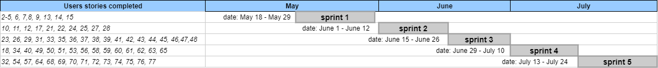
Project Management
Notes:
Project Management (schedule for entire semester) (one slide; Gantt Chart).

Slide 4
Requirements: User Stories
1 | Environment Setup
2 | Familiarize with React Native and Firebase
3 | Understand the project
4 | Back button on the lower panel
5 | Ask the age of the baby
6 | Go back in between the sign-up steps
7 | Add Setting feature
8 | Weekly notification with tips about newborn baby
9 | Add learn tab that provides health information about pregnancy
10 | Add Resources that provides about health resources
11 | Add Filter clinics by distance and services
12 | Forgot password feature
13 | Schedule appointments feature
14 | SMS notify me of my appointments
15 | Receive Notification alert
16 17 | Add and delete appointments manually Add in the learn section about STD information
18 | Delete appointment automatically the day after the appointment occurred
19 | Receive notification when a new child has been born.
20 | Add loading screen while the clinics are being fetched before the map is shown
21 | Stored the clinics in the database
22 | Redesign the lower Panel moving up and down with animation
24 | Upload and access certain medical documents
25 | Saved files listed within the app
26 | Add in the learn section about female condoms information
27 | Add shelters and display it in the map
28 | Synchronize the appointments to default calendar
29 | Add plus icon button in the upper right corner
30 | Change the Time and Date to a Picker
31 | Be able to name the files as I upload
32 | Add more resources about Zika, Hepatitis, and other health diseases.
33 | Change the lower Panel to go full screen
34 | To recognize Creole as language in the app
Notes:
4. Requirements:
4.1. User stories implemented (one or more slides).
4.2. UML use cases and the use case diagram for the implemented use cases (one or more slides).
4.3. UML sequence diagrams for the implemented use cases.

Slide 5
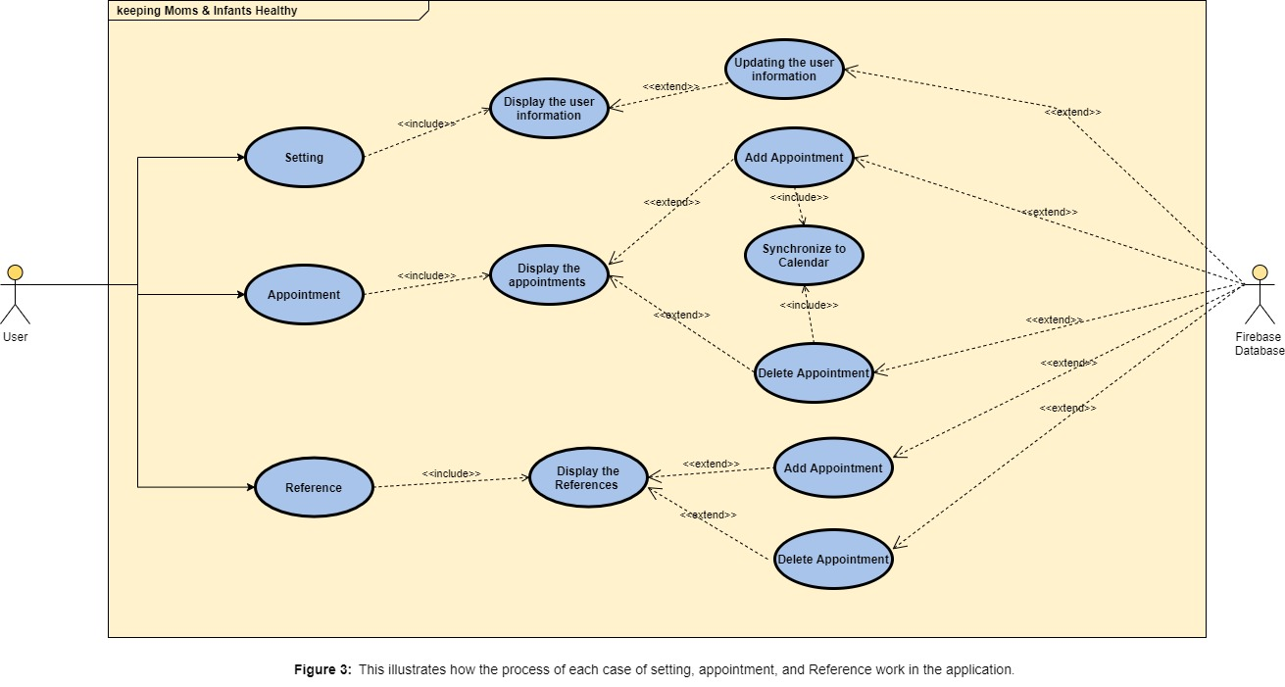
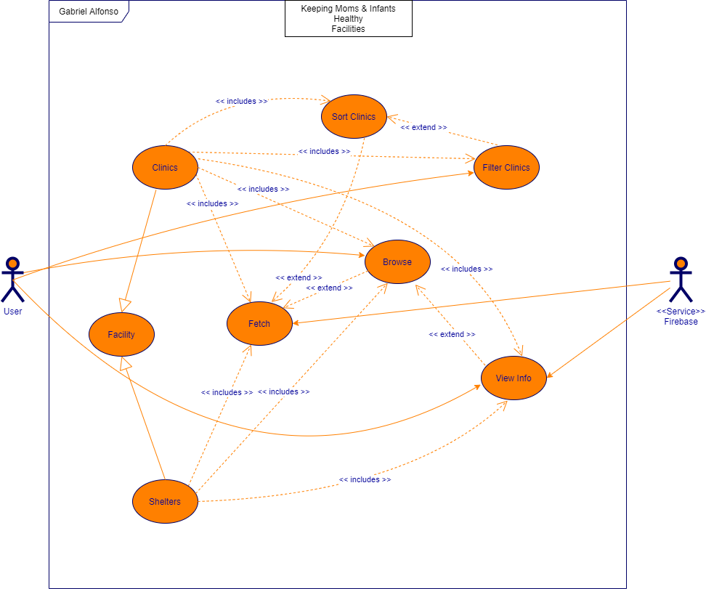
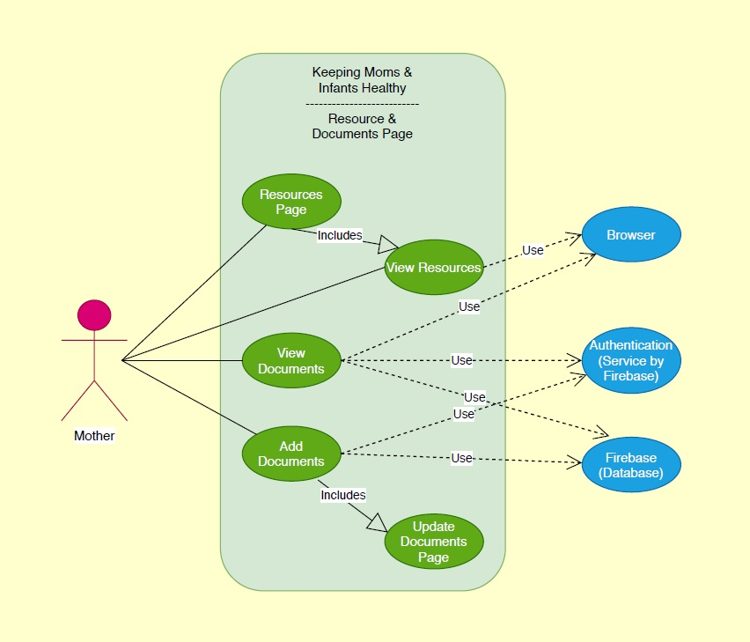
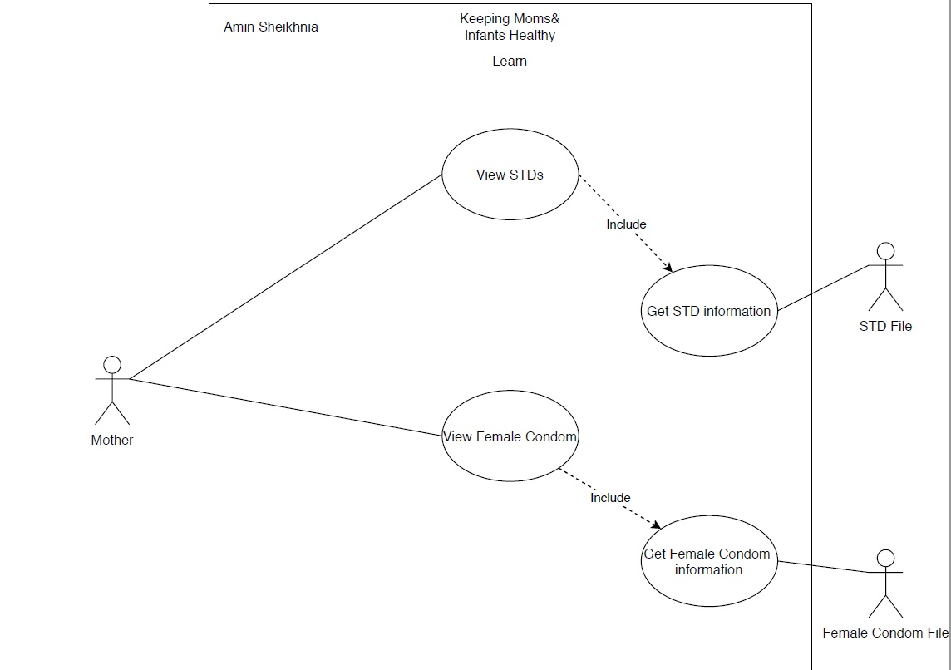
Use Case
Notes:
4. Requirements:
4.1. User stories implemented (one or more slides).
4.2. UML use cases and the use case diagram for the implemented use cases (one or more slides).
4.3. UML sequence diagrams for the implemented use cases.

Slide 6
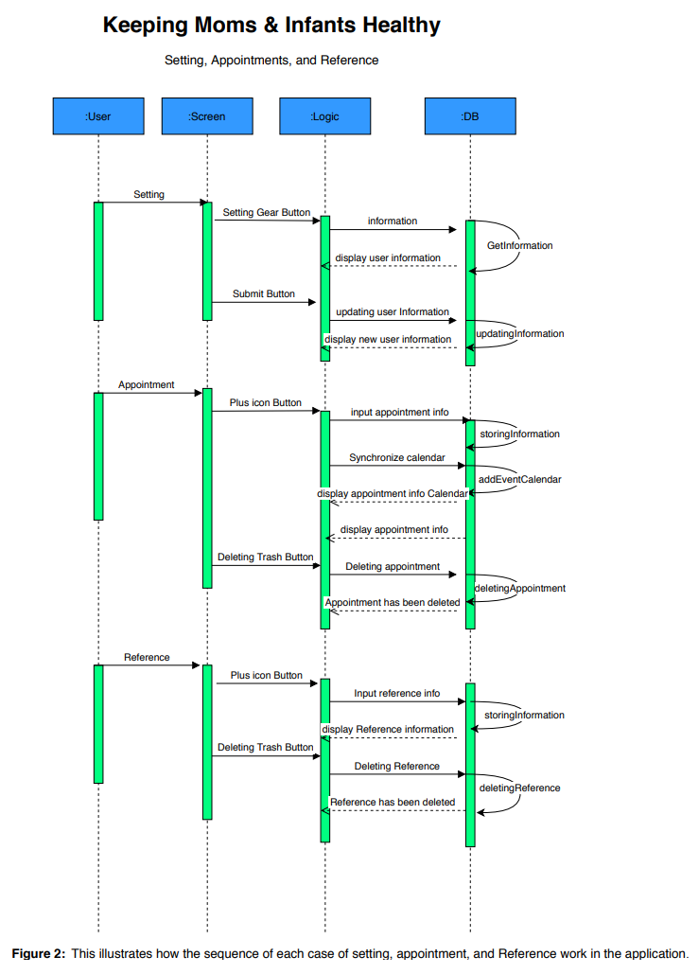
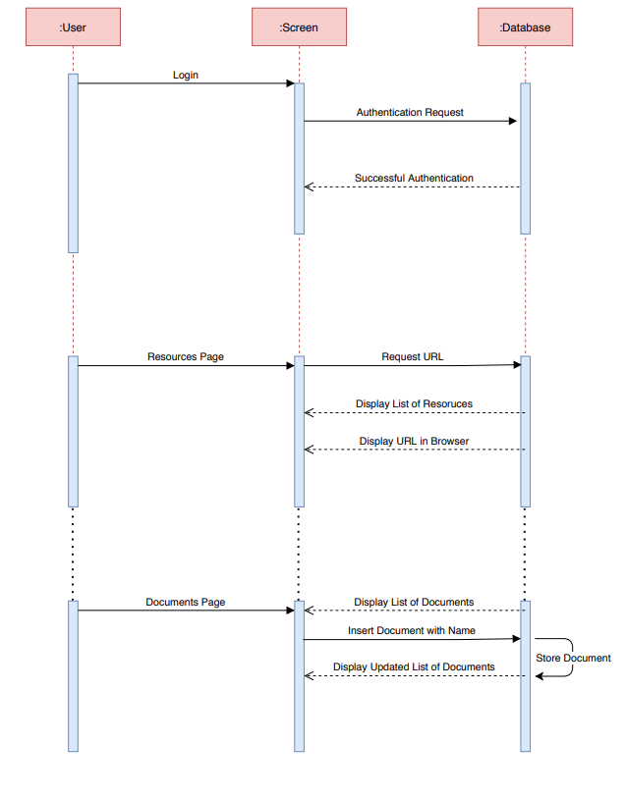
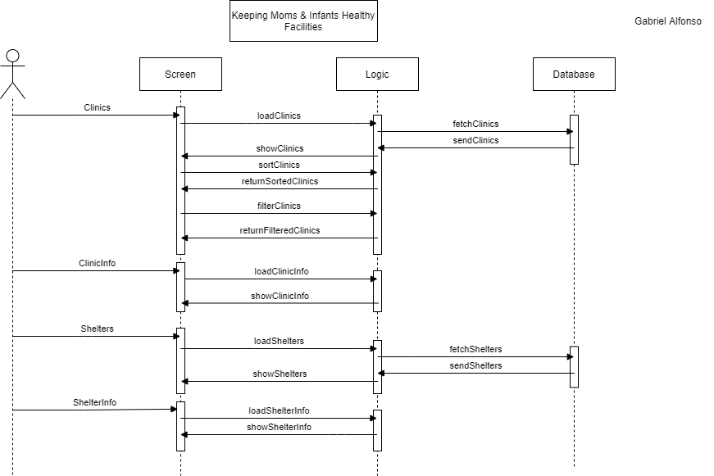
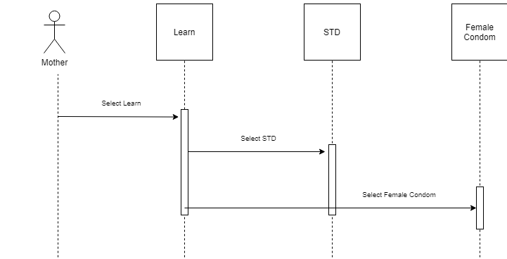
Requirements: Sequence Diagrams
Notes:
4. Requirements:
4.1. User stories implemented (one or more slides).
4.2. UML use cases and the use case diagram for the implemented use cases (one or more slides).
4.3. UML sequence diagrams for the implemented use cases.

Slide 7
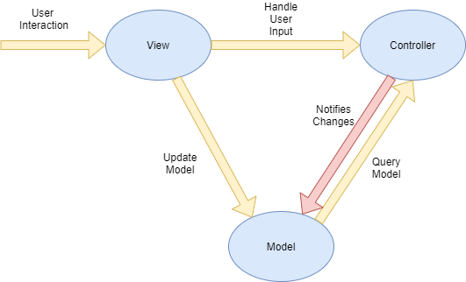
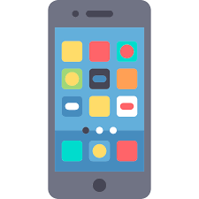



System Design: Architecture
Notes:
5. System design:
5.1. System decomposition; identify the architecture patterns used (one slide).
5.2. System deployment – h/w and s/w requirements (one slide).
5.3. Persistent data design (one slide).
5.4. Security/Privacy (one slide).

Slide 8
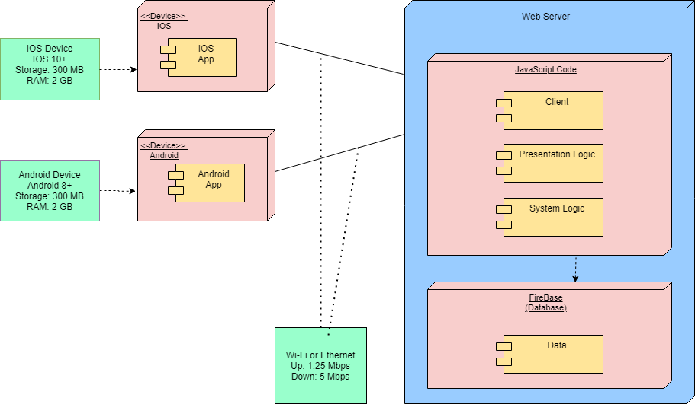
System Design: Deployment
Notes:
5. System design:
5.1. System decomposition; identify the architecture patterns used (one slide).
5.2. System deployment – h/w and s/w requirements (one slide).
5.3. Persistent data design (one slide).
5.4. Security/Privacy (one slide).

Slide 9
System Design
● View - displays the information to the user, the UI
● Controller - handle the user input
● Model - Contains the core functionality and data
Notes:
5. System design:
5.1. System decomposition; identify the architecture patterns used (one slide).
5.2. System deployment – h/w and s/w requirements (one slide).
5.3. Persistent data design (one slide).
5.4. Security/Privacy (one slide).

Slide 10
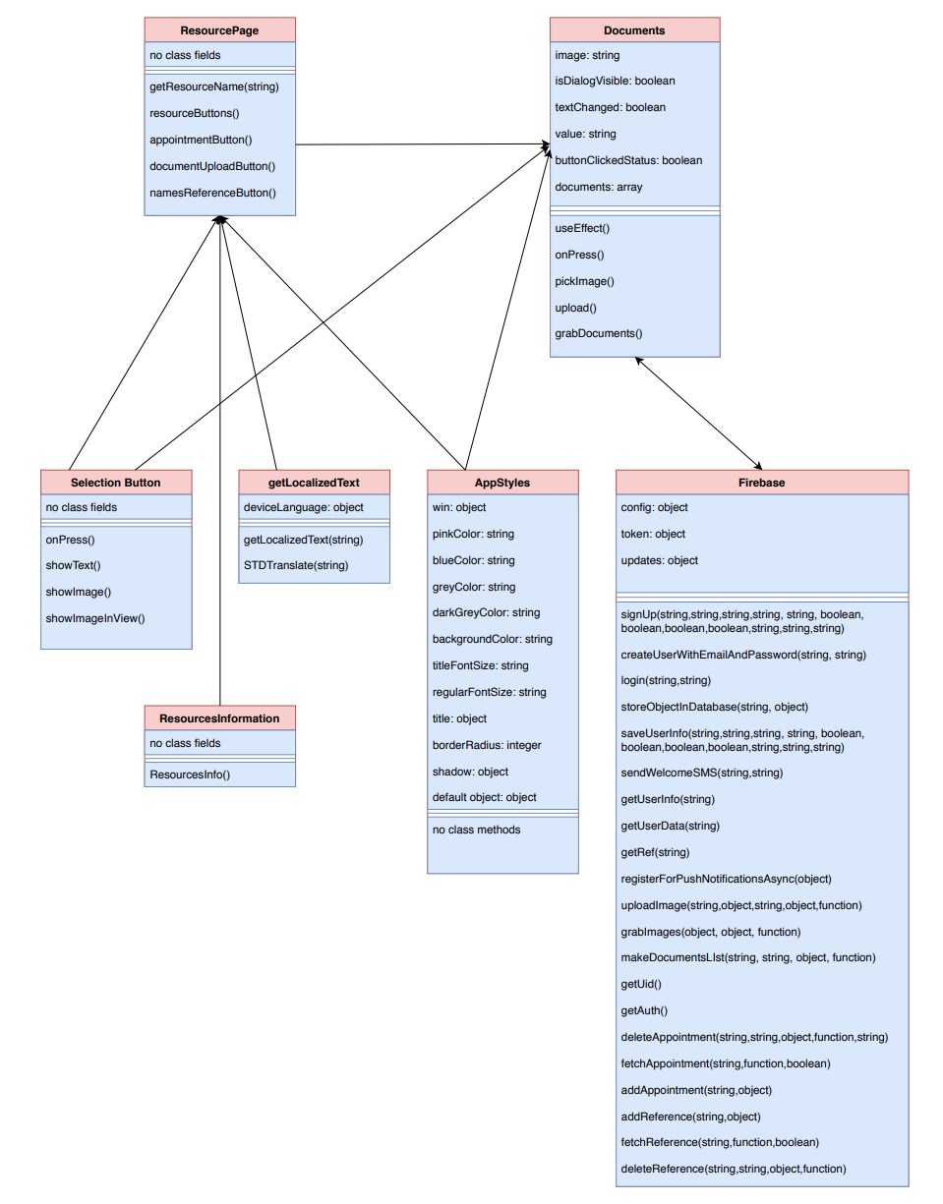
Minimal Class Diagram
Design Patterns:
Facade
Singleton
Iterator
Chain of Responsibility
Notes:
6. Detailed design:
6.1. Minimal class diagram. Identify the design patterns used (one or more slides).
6.2. State machine for the main control object or the most important object of the implemented uses cases (one or more slides).
6.3. Main algorithm used related to an implemented use case described above (one or more slides).

Slide 11
Main algorithm
Sort and filter Clinics
get User Location
Loop: through Clinics
calculate distance from clinic to user
Store distance in clinic
Sort clinics by lowest distance
Filter the Clinics by distance
Filter the Clinics by services
Notes:
6. Detailed design:
6.1. Minimal class diagram. Identify the design patterns used (one or more slides).
6.2. State machine for the main control object or the most important object of the implemented uses cases (one or more slides).
6.3. Main algorithm used related to an implemented use case described above (one or more slides).

Slide 12
Test Suites and Test Cases
Sunny Day:
On Github we all pushed to develop and we had zero conflicts and everything worked great.
When we pushed to TestFlight there were no conflicts when we tested.
Rainy Day:
The firebase database did not work due to not paying for the service.
The firebase database would not allow a user to enter the application due to the user not having an updated version of the application.
Notes:
7. Test Suites and Test Cases (one sunny day and one rainy day) for the use case represented in part (5) above (2 slides).
7.1 One sunny day and one rainy day for the implemented use cases (one or more slides).
7.2 Automated test scripts for the implemented use cases (one or more slides).

Slide 13
Summary
This application is intended to help low-income moms with the trials of taking care of a child, giving them the necessary information to take care of their child as well as themselves.
Contact Information:
https://www.linkedin.com/in/michael-llanes-68a566184/
https://www.linkedin.com/in/amin-sheikhnia-5815326a/
https://www.linkedin.com/in/noe-velasquez/
https://www.linkedin.com/in/gabriel-alfonso-2b1479176/
Questions?
Thank You!
Notes:
Summarize your contribution
Include your contact information
Ask if anyone has any questions for you.
Thank your audience

